Slide 1
2nd Sensor – final try
Date: 29/01/2020
Measured with source meter in current sourcing configuration
Source current: 100 nA
Heating voltage: 5.3 V
5.2 in the first set of measurements before 0129_1710
5.3V after that as according to the manual it is the right voltage for 20C

Slide 2
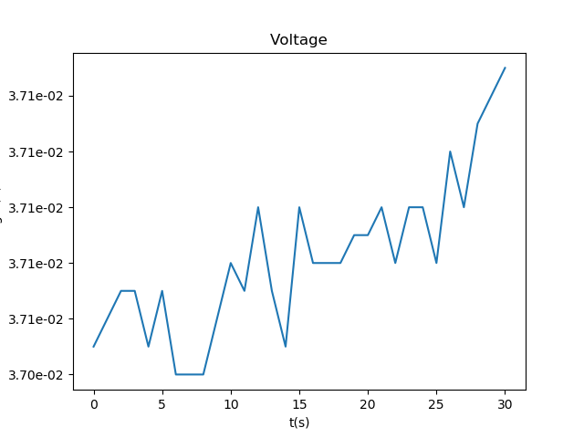
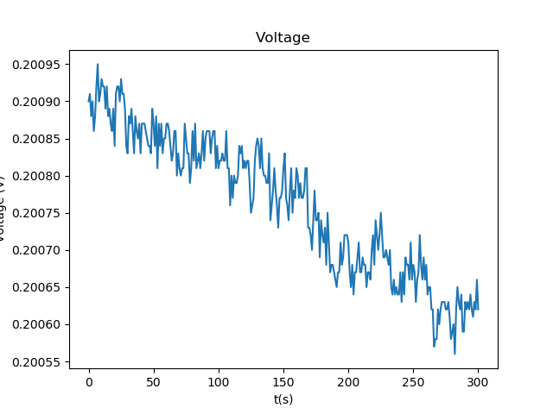
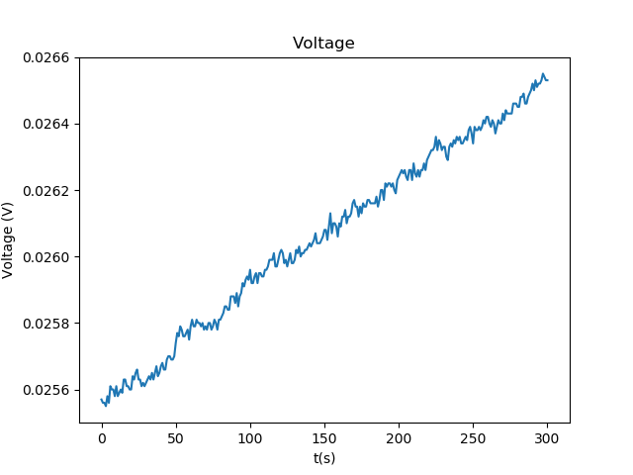
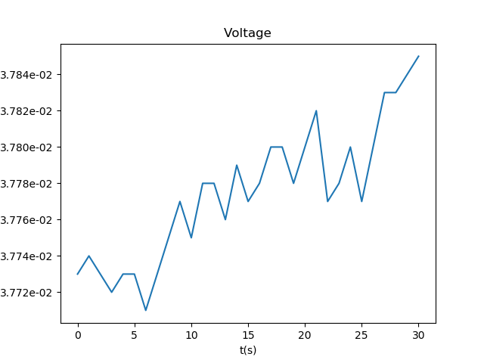
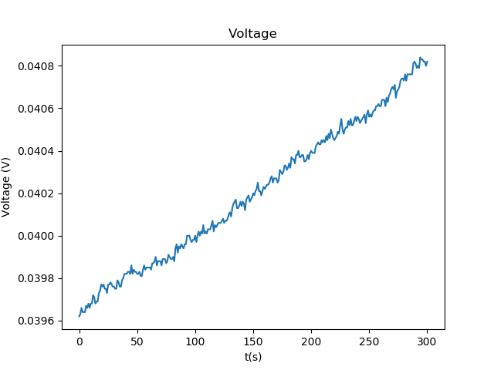
Base value in Air –waiting for stable value at 5.2V
15:59
15:08
15:37
16:03
16:12
Initial decrease, but after the resistance only increases
Over range between 0.02 and 0.04 V or
0.2 MOhm

Slide 3
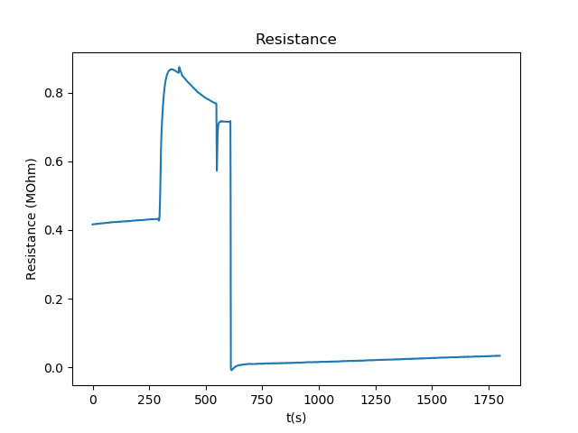
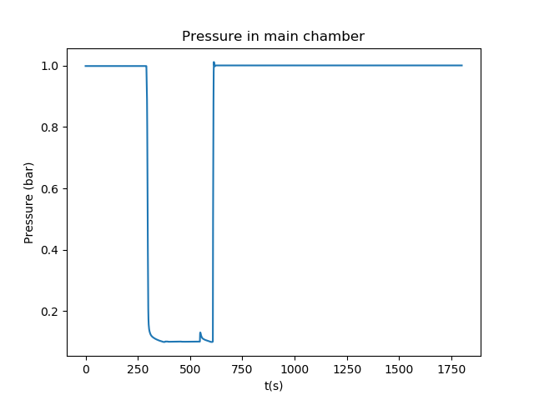
Reaction to 1000ppm 1 bar H2/Ar – 5.2V
Stable value in air and H2, with changing value in vacuum, probably due to temperature changes of the sensor due to the pressure changes and expanding gas
Extract mean resistance in air and H2 and compare with datasheet

Slide 4
Stable value in Air – 5.3V

